Slide 1
Introduction to Computer Simulation of Physical Systems
(Lecture 10)
Numerical and Monte Carlo
Methods (CONTINUED)
PHYS 3061

Slide 2
Simple Monte Carlo Evaluation of Integrals
We now explore a much different method of estimating integrals.
Consider the following example.
Suppose an irregularly shaped pond is in a field of known area A.
The area of the pond can be estimated by throwing stones so that they land at random within the boundary of the field
And counting the number of splashes
  that occur when a stone lands in a pond.

Slide 3
The area of the pond is approximately the area of the field times the fraction of stones that make a splash.
This simple procedure is an example of a Monte Carlo method.

Slide 4
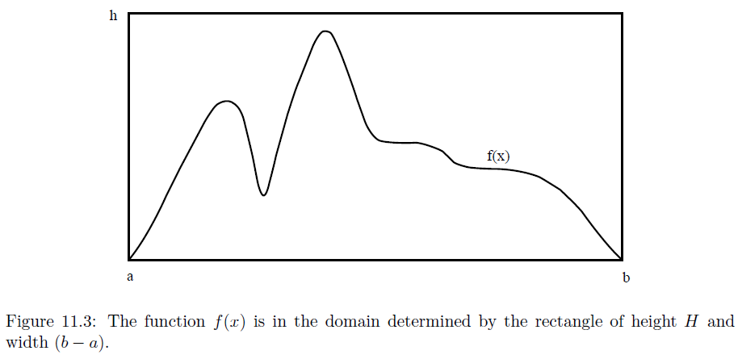
To be more specific, imagine a rectangle of height h, width b − a, and area A = h(b − a)
Such that the function f(x) is within the boundaries of the rectangle .
Compute n pairs of random numbers xi and yi with a ≤ xi ≤ b and 0 ≤ yi ≤ h.

Slide 5
The fraction of points xi, yi that satisfy the condition yi ≤ f(xi) is an estimate of the ratio of the integral of f(x) to the area of the rectangle.
Hence, the estimate F_{n} in the hit or miss method is given by F_{n} = An_{s}/n, (hit or miss method) (13)
where ns is the number of points below the curve or “splashes,”
and n is the total number of points.
Any other methods to apply random processes to compute integrations?

Slide 6
The number of points chosen at random in (13) should not be confused with the number of intervals used in the numerical methods discussed in Section 1.
Another Monte Carlo integration method is based on a mean-value theorem of integral calculus,
  which states that the definite integral (11.1) is determined by the average value of the integrand
f(x) in the range a ≤ x ≤ b: F =∫_{a}^{b} f(x)dx = (b − a)⟨f⟩. (14)

Slide 7
To determine ⟨f⟩, we choose the x_{i} at random instead of at regular intervals and sample the values of f(x).
For the one-dimensional integral,
the estimate Fn of the integral in the sample mean method is given by
  Fn = (b − a) 1/n Σf(xi) ≈ (b − a)⟨f⟩. i=1…n, (sample mean method) (15)

Slide 8
The xi are random numbers distributed uniformly in the interval a ≤ xi ≤ b, and n is the number of samples.
Note that the forms of (3) and (15) are formally identical except that the n points are chosen with equal spacing in (3) and with random spacing in (15).
We will find that for low dimensional integrals (3) is more accurate, but for higher dimensional integrals (15) does better.

Slide 9
A simple program that implements the hit or miss method is given in Listing 4.
Note the use of the Random class and the methods setSeed and nextDouble().
The primary reason that it is desirable to specify the seed
  rather than to choose it more or less at random from the time (as is done by Math.random())
  is that it is convenient to use the same random number sequence when testing a Monte Carlo program.

Slide 10
Suppose that your program gives a strange result for a particular run.
If we find an error in the program, we can use the same random number sequence
  to test whether our program changes make any difference.
Another reason for specifying the seed is
  so that other users can reproduce your results.

Slide 11
Listing 11.4: MonteCarloEstimatorApp displays the estimate of the integral for the number of samples equal to 2p.
package org.opensourcephysics.sip.ch11;

Slide 12
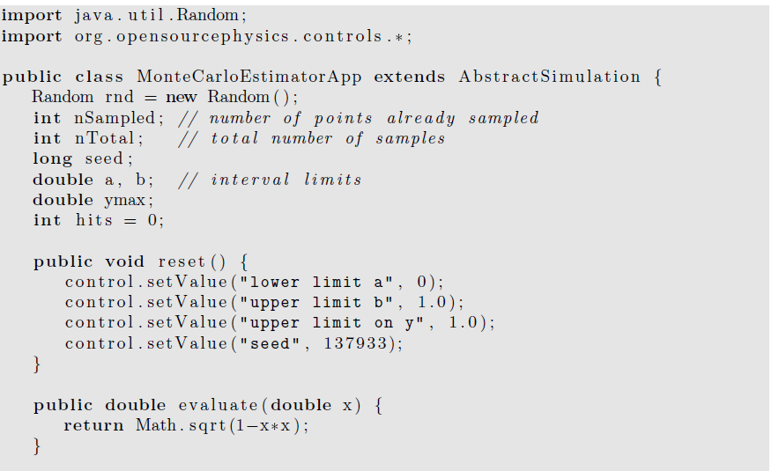

Slide 13
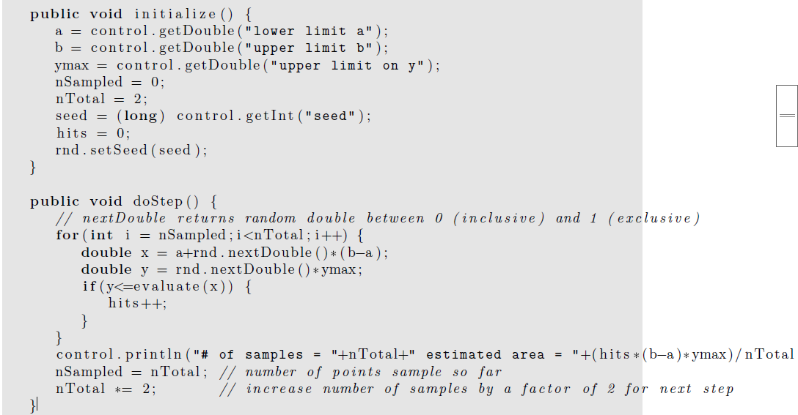

Slide 14
public static void main ( String [ ] args ) {
SimulationControl.createApp (new MonteCarloEstimatorApp ( ) ) ;
}
}

Slide 15
Multidimensional Integrals
Many problems in physics involve averaging over many variables.
For example, suppose we know the position and velocity dependence of the total energy of ten interacting particles.
In three dimensions,
  each particle has three velocity components
  and three position components.

Slide 16
Hence the total energy is a function of 60 variables,
and a calculation of the average energy per particle involves computing a d = 60 dimensional integral.
More accurately, the total energy is a function of 60 − 6 = 54 variables
  if we use center of mass and relative coordinates.

Slide 17
If we divide each coordinate into p intervals, there would be p⁶⁰ points to sum.
Clearly, standard numerical methods such as Simpson’s rule would be impractical for this example.

Slide 18
A discussion of the n dependence of the error associated with the standard numerical methods for d-dimensional integrals is given in Appendix 11A.
We show that if the error decreases as n^{−a} for d = 1,
then the error decreases as n^{−a/d} in d dimensions.
In contrast, we find that the error for all Monte Carlo integration methods decreases as n^{−1/2} independently of the dimension of the integral.

Slide 19
Because the computational time is roughly proportional to n in both the classical and Monte Carlo methods,
we conclude that for low dimensions, the classical numerical methods
  such as Simpson’s rule are preferable to Monte Carlo methods
unless the domain of integration is very complicated.
However, Monte Carlo methods are essential for higher dimensional integrals.

Slide 20
To illustrate the evaluation of multidimensional integrals, we consider the two-dimensional
Integral F = ∫_{R}f(x, y) dxdy, (16)
where R denotes the region of integration.

Slide 21
The extension to higher dimensions is straightforward,
  but tedious.
A simple illustration:
Form a rectangle that encloses the region R,
and divide this rectangle into squares of length h.
Assume that the rectangle runs from xa to xb in the x direction and from ya to yb in the y direction.

Slide 22
The total number of squares is n_{x}n_{y}, where n_{x} = (x_{b} − x_{a})/h and n_{y} = (y_{b} − y_{a})/h.
If we use the midpoint approximation, the integral F is estimated by
F ≈ΣΣ f(x_{i}, y_{j})H(x_{i}, y_{j}) h², i = 1… nx, j= 1… ny.
where x_{i} = x_{a} + (i − 1/2 )h,
y_{j} = y_{a} + (j − 1/2 )h, and the (Heaviside) function H(x, y) = 1 if (x, y) is in R and equals 0 otherwise.

Slide 23
A simple Monte Carlo method for evaluating a two-dimensional integral uses the same rectangular region,
but the n points (xi, yi) are chosen at random within the rectangle.
The estimate for the integral is then
Fn =A/nΣ f(xi, yi)H(xi, yi), i = 1 … n(18)
where A is the area of the rectangle.

Slide 24
Note that if f(x, y) = 1 everywhere, then (18) is equivalent to the hit or miss method of calculating the area of the region R.
In general, (18) represents the area of the region R multiplied by the average value of f(x, y) in R.

Slide 25
Monte Carlo Error Analysis
Both the classical numerical integration methods and the Monte Carlo methods yield approximate answers
The accuracy depends on
  the number of intervals
  or on the number of samples.

Slide 26
We have used the exact value of various integrals to determine the error
  in the Monte Carlo methods, it approaches zero as n^{−1/2} for large n,
    where n is the number of samples.
How do we estimate the error if we don’t know the exact answer?

Slide 27
Our main result : the n^{−1/2} dependence of the error is general,
and it is independent of the nature of the integrand
and independent of the number of dimensions.

Slide 28
We first determine the error for an explicit example.
Consider the Monte Carlo evaluation of the integral of f(x) = 4√(1 − x²) in the interval [0, 1].
Our result for a particular sequence of n = 10⁴ random numbers using the sample mean method is Fn = 3.1489.

Slide 29
By comparing Fn to the exact result of F = π ≈ 3.1416,
we find that the error associated with n = 10⁴ samples is approximately 0.0073.
How do we know if n = 10⁴ samples is sufficient to achieve the desired accuracy?

Slide 30
We cannot answer this question definitively
because if the actual error were known, we could correct Fn by the required amount and obtain F.
The best we can do
  to calculate the probability that the true value F is within a certain range centered about Fn.

Slide 31
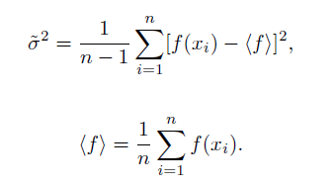
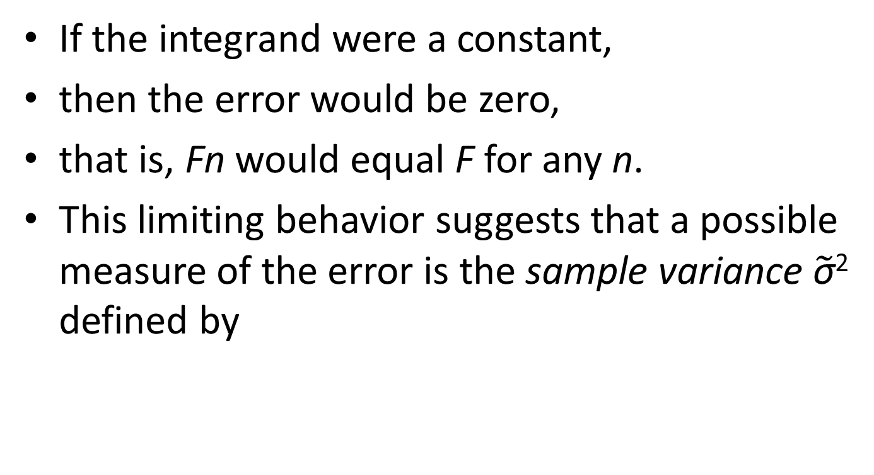
If the integrand were a constant,
then the error would be zero,
that is, Fn would equal F for any n.
This limiting behavior suggests that a possible measure of the error is the sample variance $\tilde{\text{σ}}$² defined by

Slide 32
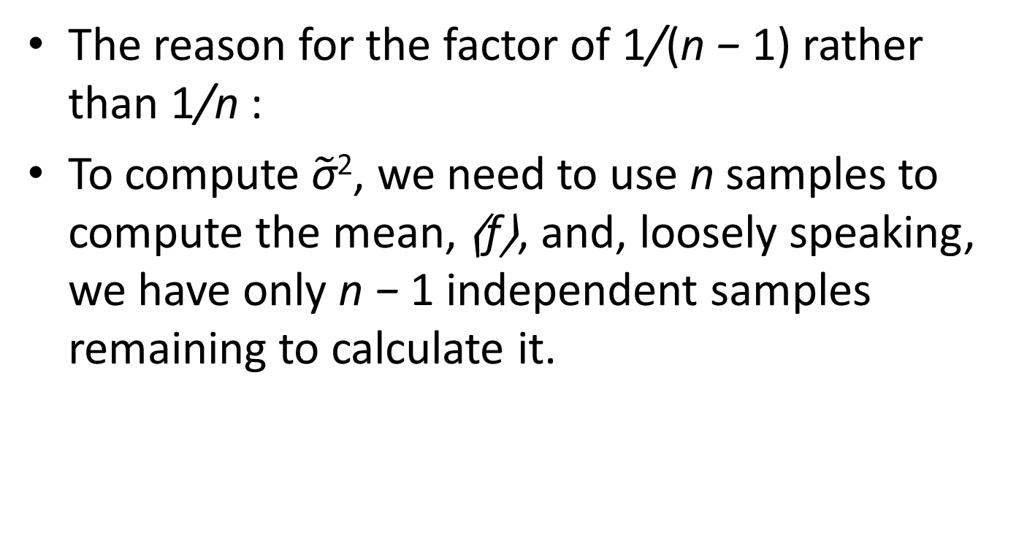
The reason for the factor of 1/(n − 1) rather than 1/n :
To compute $\tilde{\text{σ}}$², we need to use n samples to compute the mean, ⟨f⟩, and, loosely speaking, we have only n − 1 independent samples remaining to calculate it.

Slide 33
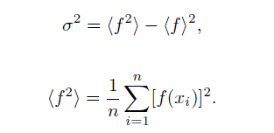
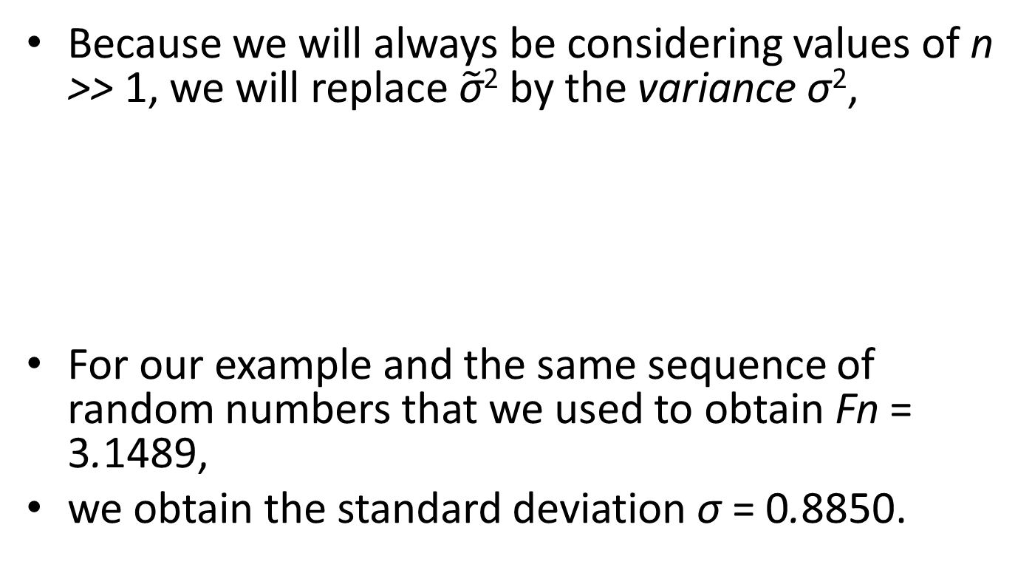
Because we will always be considering values of n >> 1, we will replace $\tilde{\text{σ}}$² by the variance σ²,
For our example and the same sequence of random numbers that we used to obtain Fn = 3.1489,
we obtain the standard deviation σ = 0.8850.

Slide 34
Because this value of σ is two orders of magnitude larger than the actual error, we conclude that σ is not a direct measure of the error.
Another clue to finding an appropriate measure of the error
  increasing n and seeing how the actual error decreases as n increases.
  In Table 11.2 we see that as n is increased from 10² to 10⁴, the actual error decreased by a factor of approximately 10, that is, as ∼ 1/n^{1/2}.

Slide 35
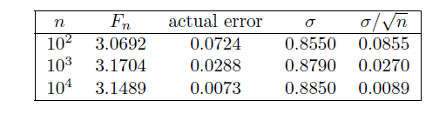
We also see that the actual error is approximately given by σ/√n.
Examples of Monte Carlo measurements of the mean value of f(x) = 4
√(1 − x²) in the interval [0, 1].
The actual error is given by the difference |Fn − π|.

Slide 36
the standard error of the means, σ_{m}, is given by
σ_{m} = σ / √ (n − 1)≈ σ/ √ n.
The interpretation of σ_{m} :
if we make many independent measurements of Fn,
each with n data points,
then the probable error associated with any single measurement is σ_{m}.

Slide 37
The more precise interpretation of σ_{m} :
F_{n}, our estimate for the mean, has a 68% chance of being within σ_{m} of the “true” mean,
and a 97% chance of being within 2σ_{m}.
This interpretation assumes a Gaussian distribution of the various measurements.

Slide 38
The quantity F_{n} is an estimate of the average value of the data points.
As we increase n, the number of data points,
we do not expect our estimate of the mean to change much.
What changes as we increase n is our confidence in our estimate of the mean.
Similar considerations hold
  for our estimate of σ,
  which is why σ is not a direct measure of the error.

Slide 39
The error estimate assumes that the data points are independent of each other.
However, in many situations the data is correlated!
and we have to be careful about how we estimate the error.

Slide 40
For example, suppose that instead of choosing n random values for x,
We instead start with a particular value x₀ and then randomly add increments such that the ith value of x is given by x_{i} = x_{i−1} + (2r − 1)δ,
where r is uniformly distributed between 0 and 1 and δ = 0.01.
Clearly, the x_{i} are now correlated.

Slide 41
We can still obtain an estimate for the integral,
but we cannot use σ/√n as the estimate for the error
because this estimate would be smaller than the actual error.
However, we expect that two data points, xi and xj , will become uncorrelated if |j − i| is sufficiently large.

Slide 42
How can we tell when |j − i| is sufficiently large?
One way is to group the data by averaging over m data points.
We take f^{(m)}₁ to be the average of the first m values of f(x_{i}),
f^{(m)}₂ to be the average of the next m values, and so forth.

Slide 43
Then we compute σ_{s}/√s,
Where s = n/m is the number of f^{(m)}_{i} data points,
each of which is an average over m of the original data points,
σ_{s} is the standard deviation of the s data points,
We do this grouping for different values of m (and s)
the value of m for which σ_{s}/√s becomes approximately independent of m.
This ratio is our estimate of the error of the mean.

Slide 44
We see that we can make the probable error as small as we wish by either increasing n,
The number of data points,
or by reducing the variance σ².
Several reduction of variance methods are introduced in Sections 11.6 and 11.7.

Slide 45
Nonuniform Probability Distributions
In Sections 11.2 and 11.4,
how uniformly distributed random numbers can be used to estimate definite integrals.
more efficient to sample the integrand f(x) more often in regions of x where the magnitude of f(x) is large or rapidly varying.

Slide 46
Because importance sampling methods require non-uniform probability distributions,
we first consider several methods for generating random numbers that are not distributed uniformly.
In the following, we will denote r as a member of a uniform random number sequence in the unit interval 0 ≤ r < 1.

Slide 47
Suppose that two discrete events 1 and 2 occur
with probabilities p1 and p2 such that p1+p2 =1.
How to choose the two events with the correct probabilities using a uniform probability distribution?

Slide 48
For this simple case, it is clear that we choose event 1 if r < p1;
otherwise, we choose event 2.
If there are three events with probabilities p1, p2, and p3,
then if r < p1
we choose event 1;
else if r < p1 + p2, we choose event 2;
else we choose event 3.

Slide 49
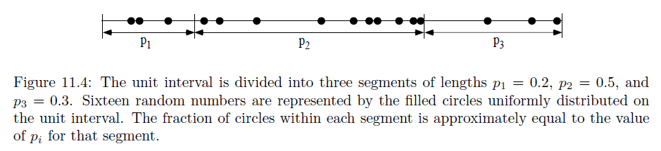
We can visualize these choices by dividing a line segment of unit length into three pieces

Slide 50
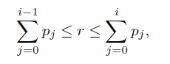
Now consider n discrete events.
How do we determine which event, i, to choose given the value of r?
The generalization of the procedure we have followed for n = 2 and 3 is to find the value of i that satisfies the condition
where we have defined p0 ≡ 0.

Slide 51
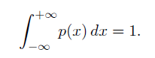
Now consider a continuous nonuniform probability distribution.
to take the limit of the above equation and associate pi with p(x)Δx,
where the probability density p(x) is defined such that p(x)Δx is the probability that the event x is in the interval between x and x + Δx.
The probability density p(x) is normalized such that

Slide 52
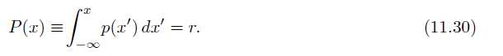
In the continuum limit the two sums become the same integral and the inequalities become equalities.
Hence we can write
we see that the uniform random number r corresponds to the cumulative probability distribution function P(x),
which is the probability of choosing a value less than or equal to x.

Slide 53
The function P(x) should not be confused with the probability density p(x) or the probability p(x)Δx.
In many applications the meaningful range of values of x is positive.
In that case, we have p(x) = 0 for x < 0.

Slide 54
the inverse transform method for generating random numbers distributed according to the function p(x).
This method involves generating a random number r
and solving (11.30) for the corresponding value of x.
As an example of the method,
we use (11.30) to generate a random number sequence according to the uniform probability distribution on the interval a ≤ x ≤ b.
The desired probability density p(x) is
p(x) =1/(b − a) a ≤ x ≤ b; 0, otherwise

Slide 55
The cumulative probability distribution function P(x) for a ≤ x ≤ b :
P(x) =(x − a)/(b − a).
If we solve for x, the desired relation is:
x = a + (b − a)r.
The variable x is distributed according to the probability distribution p(x).

Slide 56
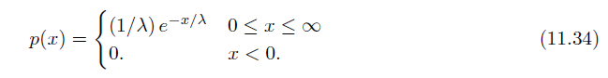
We next apply the inverse transform method to the probability density function
If we substitute (11.34) into (11.30) and integrate, we find the relation
r = P(x) = 1 − e^{−x/λ}. (11.35)

Slide 57
The solution of (11.35) for x yields x = −λ ln(1−r).
Because 1−r is distributed in the same way as r, we can write x = −λ ln r. (11.36)
The variable x found from (11.36) is distributed according to the probability density p(x) given by (11.34).
Because the computation of the natural logarithm in (11.36) is relatively slow,
the inverse transform method might not be the most efficient method to use in this case.

Slide 58
From the above examples,
two conditions must be satisfied in order to apply the inverse transform method:
the form of p(x) must allow us to perform the integral in (11.30) analytically,
and it must be practical to invert the relation P(x) = r for x.

Slide 59
The Gaussian probability density,
p(x) =[1/(2πσ2)^{1/2} ]e^{−x^2/2σ^2}, (11.37)
is an example of a probability density
for which the cumulative distribution P(x) cannot be obtained analytically.
However, we can generate the two-dimensional probability p(x, y) dx dy given by
p(x, y) dx dy = (1/2πσ² )e^{−(x^2+y^2)/2σ^2}dx dy.

Slide 60
First, we make a change of variables to polar coordinates:
r = (x² + y²)^{1/2}, θ = tan⁻¹ y/x. (11.39)
We let ρ = r²/2 and write the two-dimensional probability as
p(ρ, θ) dρ dθ =(1/2π)e^{−ρ}dρ dθ, (11.40)
where we have set σ = 1.

Slide 61
If we generate ρ according to the exponential distribution (11.34)
and generate θ uniformly in the interval 0 ≤ θ < 2π,
then the quantities x = (2ρ)^{1/2} cos θ and y = (2ρ)^{1/2} sin θ (Box-Muller method)
will each be generated according to (11.37) with zero mean and σ = 1.
(Note that the two dimensional density (11.38) is the product of two independent one-dimensional Gaussian distributions.)
This way of generating a Gaussian distribution is known as the Box-Muller method.

Slide 62
Importance Sampling
In Section 11.4 we found that
the error associated with a Monte Carlo estimate is proportional to the standard deviation σ of the integrand
and inversely proportional to the square root of the number of samples.

Slide 63
Hence, there are only two ways of reducing the error in a Monte Carlo estimate
– either increase the number of samples or reduce the variance.
Clearly the latter choice is desirable because it does not require much more computer time.
In this section we introduce importance sampling techniques that reduce σ and improve the efficiency of each sample.

Slide 64
To do importance sampling in the context of numerical integration,
we introduce a positive function p(x) such that ∫ ^{b}_{a} p(x) dx = 1, (11.43)
and rewrite the integral (11.1) as
F =∫ ^{b}_{a} [f(x)/p(x)] p(x) dx.(11.44)

Slide 65
We can evaluate the integral (11.44) by sampling according to the probability distribution p(x)
and constructing the sum
Fn =1/nΣf(xi)/p(xi). i= 1 to n, (11.45)
The sum (11.45) reduces to (11.15) for the uniform case p(x) = 1/(b − a).

Slide 66
The idea is to choose a form for p(x) that minimizes the variance of the ratio f(x)/p(x).
To do so we choose a form of p(x) that mimics f(x) as much as possible,
particularly where f(x) is large.
A suitable choice of p(x) would make the integrand f(x)/p(x) slowly varying,
and hence reduce the variance.

Slide 67
Because we cannot evaluate the variance analytically in general, we determine σ a posteriori.
As an example, we consider the integral
F =∫ ¹₀ exp (−x²)dx.
The estimate of F with p(x) = 1 for 0 ≤ x ≤ 1 is shown in the second column of Table 11.3.
A simple choice for the weight function is p(x) = Ae^{−x}, where A is chosen such that p(x) is normalized on the unit interval.

Slide 68
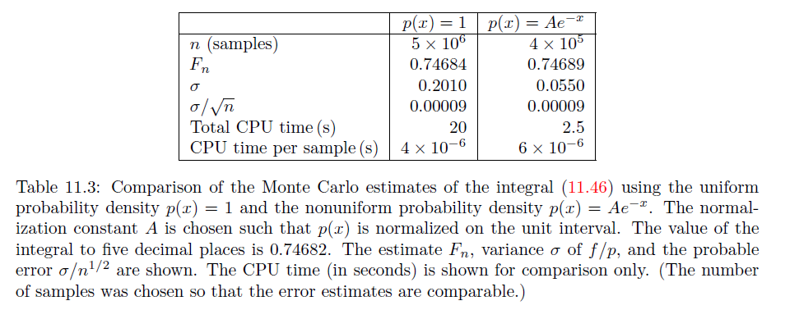

Slide 69
Note that this choice of p(x) is positive definite and is qualitatively similar to f(x).
The results are shown in the third column of Table 11.3.
We see that although the computation time per sample for the non-uniform case is larger,
the smaller value of σ makes the use of the non-uniform probability distribution more efficient.

Slide 70
Metropolis Algorithm
Another way of generating an arbitrary nonuniform probability distribution was introduced by Metropolis, Rosenbluth, Rosenbluth, and Teller in 1953.
The Metropolis algorithm is a special case of an importance sampling procedure in which certain possible sampling attempts are rejected (see Appendix 11C).

Slide 71
The Metropolis method is useful for computing averages of the form
⟨f⟩ =∫f(x)p(x) dx/[ ∫p(x) dx], (11.52)
where p(x) is an arbitrary function that need not be normalized.
For simplicity, we introduce the Metropolis algorithm
  in the context of estimating one-dimensional definite integrals.
Suppose that we wish to use importance sampling to generate random variables according to p(x).

Slide 72
The Metropolis algorithm produces a random walk of points {xi}
  whose asymptotic probability distribution approaches p(x) after a large number of steps.
The random walk is defined by specifying a transition probability T(x_{i} → x_{j}) from one value x_{i} to another value x_{j}
such that the distribution of points x₀, x₁, x₂, . . . converges to p(x).
It can be shown that it is sufficient (but not necessary) to satisfy the detailed balance condition
p(xi)T(xi → xj) = p(xj)T(xj → xi). (11.53)
  We’ll give the detailed proof in PHYS4370.

Slide 73
The relation (11.53) does not specify T(x_{i} → x_{j}) uniquely.
A simple choice of T(x_{i} → x_{j}) that is consistent with (11.53) is
T(x_{i} → x_{j}) = min[1,p(x_{j})/p(x_{i})]. (11.54)
If the “walker” is at position x_{i} and we wish to generate x_{i+1}, we can implement this choice of
T(x_{i} → x_{i+1}) by the following steps:

Slide 74
1. Choose a trial position x_{trial} = x_{i} + δ_{i},
  where δi is a uniform random number in the interval [−δ, δ].
2. Calculate w = p(x_{trial})/p(xi).
3. If w ≥ 1, accept the change and let x_{i+1} = x_{trial}.
4. If w < 1, generate a random number r.
5. If r ≤ w, accept the change and let x_{i+1} = x_{trial}.
6. If the trial change is not accepted, then let x_{i+1} = x_{i}.

Slide 75
It is necessary to sample many points of the random walk before the asymptotic probability distribution p(x) is attained.
How do we choose the maximum step size δ?
If δ is too large, only a small percentage of trial steps will be accepted and the sampling of p(x) will be inefficient.
On the other hand, if δ is too small, a large percentage of trial steps will be accepted, but again the sampling of p(x) will be inefficient.

Slide 76
A rough criterion for the magnitude of δ is that approximately one third to one half of the trial steps should be accepted.
We also wish to choose the value of x₀
  such that the distribution {xi} will approach the asymptotic distribution as quickly as possible.
An obvious choice is to begin the random walk at a value of x at which p(x) is a maximum.
A code fragment that implements the Metropolis algorithm is given below.

Slide 77
double xtrial = x + (2* rnd.nextDouble ( ) - 1.0 ) * delta;
double w = p( xtrial )/p( x ) ;
i f (w > 1 || w > rnd.nextDouble ( ) ) {
x = xtrial ;
naccept++; // number of acceptances
}
Read neutron transport section if you are interested.

Slide 79
HW3 is optional in this year

Slide 80
Error Estimates for Numerical Integration
We derive the dependence of the truncation error on the number of intervals for the numerical integration methods considered in Sections 11.1 and 11.3.
These estimates are based on the assumed adequacy of the Taylor series expansion of the integrand f(x):
f(x) = f(xi) + f′(xi)(x − xi) +1/2f′′(xi)(x − xi)2 + . . . , (11.64)

Slide 81
and the integration of (11.1) in the interval xi ≤ x ≤ xi+1:
∫ ^{xi+1} _{xi} f(x) dx = f(xi)Δx +1/2f′(xi)(Δx)² +1/6f′′(xi)(Δx)³ + . . . (11.65)
We first estimate the error associated with the rectangular approximation with f(x) evaluated at the left side of each interval.

Slide 82
The error Δi in the interval [xi, xi+1] is the difference between (11.65) and the estimate f(xi)Δx:
Δi =[∫ ^{xi+1}_{xi}f(x) dx]− f(xi)Δx ≈ 1/2f′(xi)(Δx)². (11.66)
We see that to leading order in Δx, the error in each interval is order (Δx)². Because there are a total of n intervals and Δx = (b − a)/n,
the total error associated with the rectangular approximation is nΔ_{i} ∼ n(Δx)² ∼ n⁻¹.

Slide 83
The estimated error associated with the trapezoidal approximation can be found in the same way.
The error in the interval [xi, xi+1] is the difference between the exact integral and the estimate,
1/2 [f(xi) + f(xi+1)]Δx:
Δ_{i} =[ ∫ ^{xi+1}_{xi}f(x) dx]− ½ [f(xi) + f(xi+1)]Δx. (11.67)

Slide 84
If we use (11.65) to estimate the integral and (11.64) to estimate f(xi+1) in (11.67),
we find that the term proportional to f′ cancels and that the error associated with one interval is order (Δx)³.
Hence, the total error in the interval [a, b] associated with the trapezoidal approximation is order n⁻².

Slide 85
Because Simpson’s rule is based on fitting f(x) in the interval [xi−1, xi+1] to a parabola,
error terms proportional to f′′ cancel.
We might expect that error terms of order f′′′(xi)(Δx)⁴ contribute,
but these terms cancel by virtue of their symmetry.

Slide 86
Hence the (Δx)⁴ term of the Taylor expansion of f(x) is adequately represented by Simpson’s rule.
If we retain the (Δx)⁴ term in the Taylor series of f(x),
we find that the error in the interval [xi, xi+1] is of order f′′′′(xi)(Δx)⁵
and that the total error in the interval [a, b] associated with Simpson’s rule is O(n⁻⁴).

Slide 87
The error estimates can be extended to two dimensions in a similar manner.
The two dimensional integral of f(x, y) is the volume under the surface determined by f(x, y).
In the “rectangular” approximation,
the integral is written as a sum of the volumes of parallelograms
  with cross sectional area ΔxΔy
  and a height determined by f(x, y) at one corner.

Slide 88
To determine the error, we expand f(x, y) in a Taylor series
f(x, y) = f(x_{i}, y_{i}) +(∂f(xi, y_{i})/∂x) (x − xi) + (∂f(xi, yi) /∂y) (y − yi) + . . . , (11.68)
and write the error as
Δi =[∫ ∫f(x, y) dxdy]− f(x_{i}, y_{i})ΔxΔy. (11.69)

Slide 89
If we substitute (11.68) into (11.69) and integrate each term,
we find that the term proportional to f cancels
and the integral of (x − x_{i}) dx yields 1/2(Δx)².
The integral of this term with respect to dy gives another factor of Δy.
The integral of the term proportional to (y −y_{i}) yields a similar contribution.

Slide 90
Because Δy also is order Δx,
the error associated with the intervals [xi, xi+1] and [yi, yi+1] is to leading order in Δx:
Δi ≈ 1/2[f′x(xi, yi) + f′y(xi, yi)](Δx)³. (11.70)
We see that the error associated with one parallelogram is order (Δx)³.
Because there are n parallelograms,
the total error is order n(Δx)³.
However in two dimensions, n = A/(Δx)²,
And hence the total error is order n^{−1/2}.
In contrast, the total error in one dimension is order n⁻¹.

Slide 91
The corresponding error estimates for the two-dimensional generalizations of the trapezoidal approximation and Simpson’s rule are order n⁻¹ and n⁻² respectively.
In general, if the error goes as order n^{−a} in one dimension,
then the error in d dimensions goes as n^{−a/d}.
In contrast, Monte Carlo errors vary as n^{−1/2} independent of d.
Hence for large enough d, Monte Carlo integration methods will lead to smaller errors for the same choice of n.

